Slide 1
Hospital Workforce and Management System
Team Members
Vemula Muni Karthik
Vasundhara B
V Sri Sai Ankit
3rd year , Dept of Information Technology, SSN College Of Engineering , Chennai

Slide 2
Problem Statement
Develop a Hospital Management System with an AI-driven scheduling algorithm that optimizes staff allocation, considers individual preferences, and ensures each doctor has a designated day off. The system aims to enhance patient care responsiveness and staff well-being while maximizing operational efficiency.

Slide 3
Problem description
The project aims to create a Hospital Management System focused on optimizing staff scheduling. This system will incorporate an advanced scheduling algorithm to intelligently allocate doctors, nurses, and receptionists based on availability, preferences, and leave requests.
Users will have the ability to view their schedules, request leaves, and receive approvals from administrators. In emergency situations, a dedicated on-call doctor will be assigned, ensuring swift and efficient patient care.
By leveraging AI-based scheduling, the system aims to improve operational efficiency, reduce scheduling conflicts, and enhance overall patient experience. The algorithm will dynamically adjust schedules to accommodate leave requests, minimizing disruptions in day-to-day operations.

Slide 4
Objectives
Optimize Staff Allocation: Develop an automated system to efficiently allocate hospital staff across departments and shifts, ensuring appropriate coverage while adhering to individual preferences and availability.
Real-Time Updates and Adaptability: Create a platform that enables real-time scheduling updates and adjustments, allowing immediate modifications to staff assignments based on changing requirements or unforeseen circumstances.
Streamline Leave Management: Implement a comprehensive leave management module to handle staff leave requests seamlessly, ensuring replacement coverage and minimizing disruptions to hospital operations.
User-Centric Interface: Design an intuitive user interface for administrators to oversee staff schedules effortlessly, granting them the ability to manage workforce allocation, approve leave, and handle scheduling intricacies effectively.
Enhanced Operational Efficiency: Improve overall hospital efficiency by reducing scheduling conflicts, optimizing shift coverage, and fostering a balanced workforce, ultimately enhancing patient care quality and operational effectiveness.

Slide 5
Innovative Ideas
Day and Shift-Specific Scheduling: The system intelligently schedules staff based on the specific day and shift preferences of each doctor. This level of customization ensures that schedules align with individual availability and preferences.
Day Off Allocation: Each doctor is allocated atleast a designated day off within their schedule. This automated feature ensures that every staff member receives a well-deserved break, enhancing overall well-being and preventing burnout.
Dynamic Staff Allocation: The system dynamically allocates doctors, nurses, and receptionists based on real-time demand and availability. This responsiveness ensures that the right personnel are assigned to meet patient needs effectively.

Slide 6
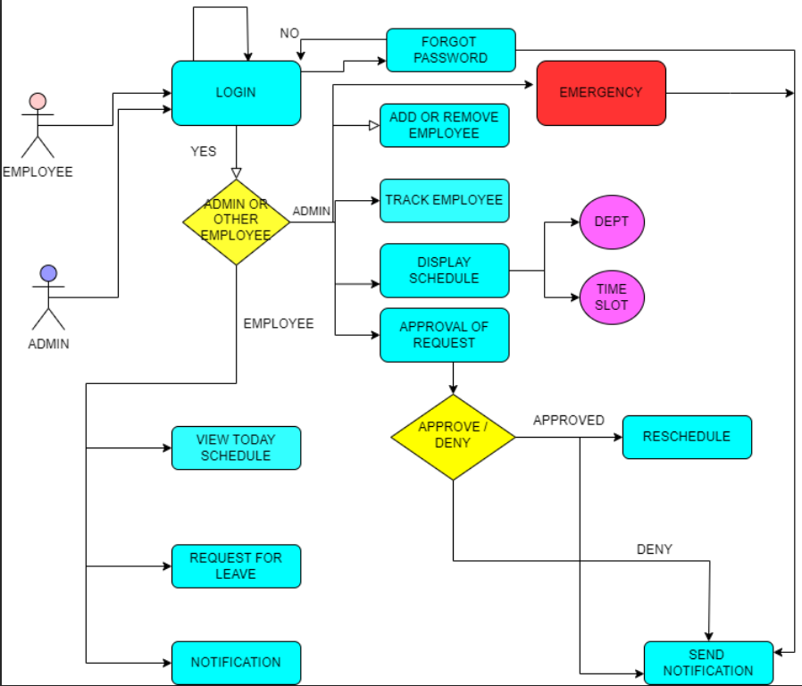
Block Diagram

Slide 7
Methodologies
Agile Approach: Utilizing an Agile methodology, such as Scrum ,allows for iterative development, flexibility in adapting to evolving requirements, and frequent communication and collaboration among team members.
Tools:
Frontend: HTML, CSS, JavaScript
Backend: Python (Flask)
Database: MongoDB
Integration: Flask for backend integration

Slide 8
Methodologies(continued)
Algorithm The CSP Scheduling Algorithm, enhanced with Forward Checking, is essential for effectively allocating staff in the Hospital Management System. It refines assignments iteratively, anticipating and resolving scheduling conflicts. In case of conflicts, Backtracking, combined with Forward Checking, efficiently explores alternative allocations. This method ensures optimized schedules, benefiting both staff satisfaction and patient care quality. Variables: Receptionists, Doctors, Nurses Domains: Time slots available during operational hours Constraints: Preferred time slots for each staff member. Specific days off requested by staff members

Slide 9
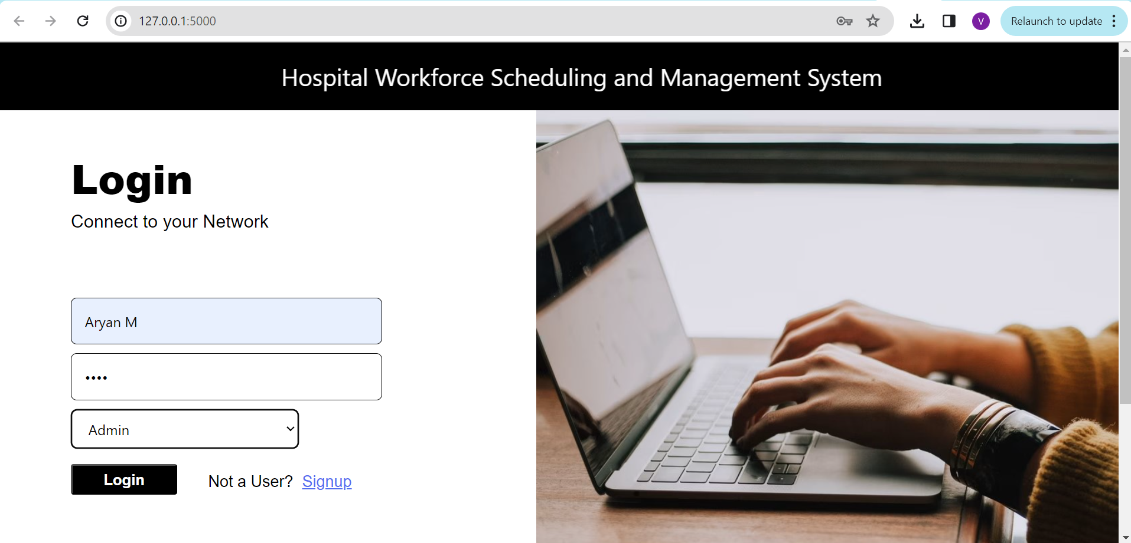
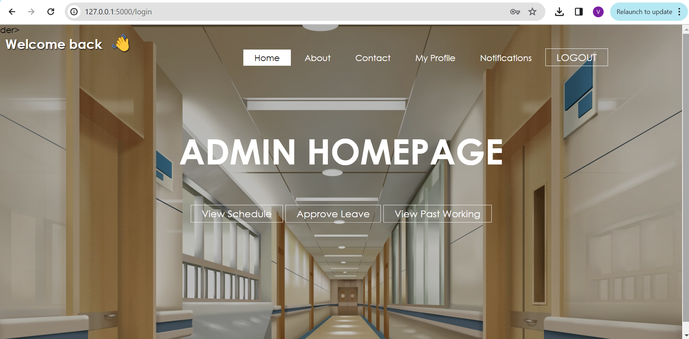
Sample Outputs
Login page for an employee
Home page for Admin

Slide 10
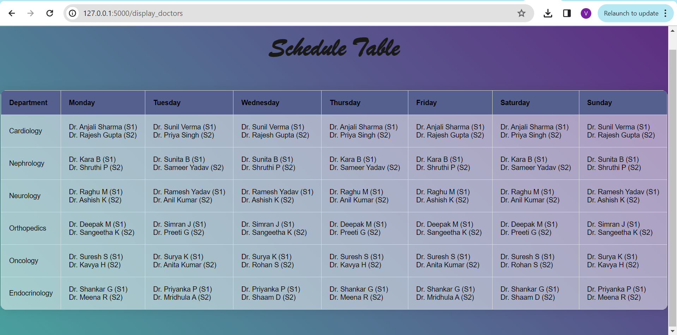
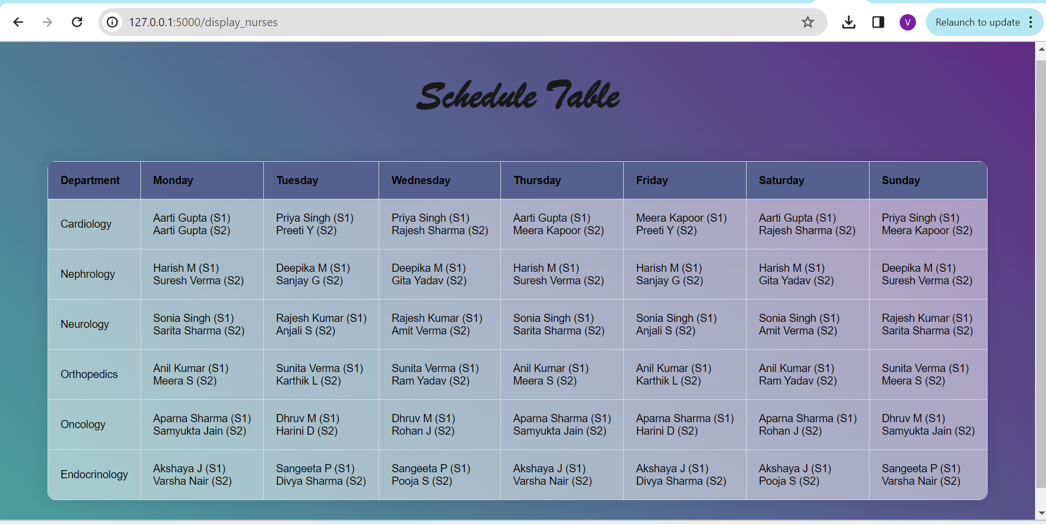
Sample outputs(continued)
Doctor Schedule
Nurse schedule

Slide 11
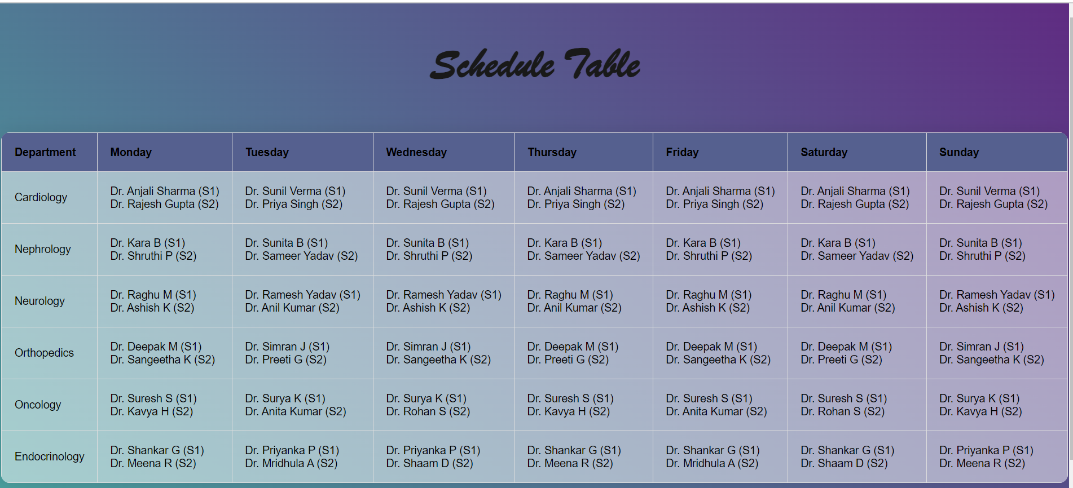
Dr. Rajesh Gupta is replaced by Dr. Priya Singh in this scenario
After admin approval-Leave handling
Suppose Dr. Rajesh Gupta requests for leave and his leave is approved,then he will be replaced by a doctor working in the same shift

Slide 12
References
https://github.com/nccvector/genetic-algorithm-path-planning/blob/master/main.py
https://algorithm-visualizer.org/
https://www.freecodecamp.org/news/path-finding-algorithm-visualizer-tutorial/
https://iopscience.iop.org/article/10.1088/1742-6596/2246/1/012081/pdf
https://www.emerald.com/insight/content/doi/10.1108/01445150910972921/full/html?skipTracking=true

